Slide 1
.NET Framework Architecture

Slide 2
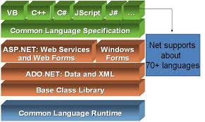

Slide 3
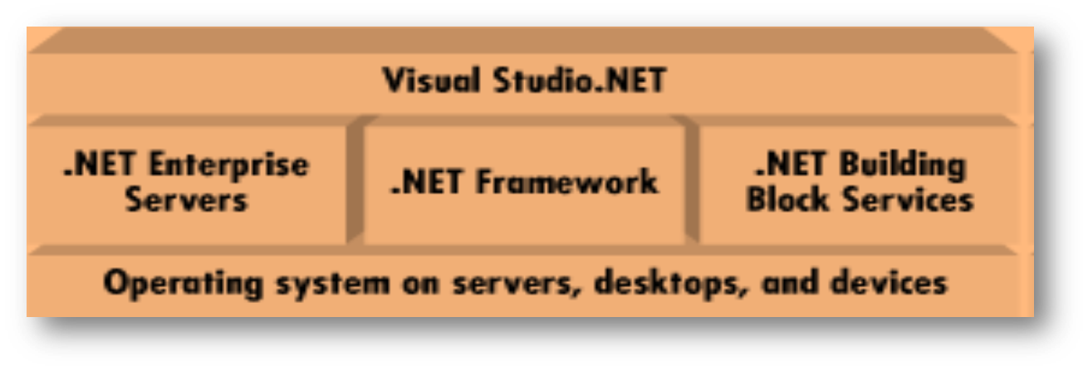
.NET Platform
It includes four product groups:
  Tool and Libraries
  Web Services
  .NET Enabled Servers
  Devices (non-PC devices)
Notes:
The .NET platform is a new development framework with a new programming interface to Windows services and APIs.
Incorporated into .NET are COM+ component services; the ASP web development framework; a commitment to XML and object-oriented design; support for new web services protocols such as SOAP, WSDL, and UDDI.
.Net Platform consists of four product groups
Tools and Libraries: A set of languages including C#, VB.NET, a set development tools including Visual Studio 2005, class library to develop web services, web application and windows applications. It has Common language runtime to execute the objects within framework.
Web Services: People nowadays use SOA to develop their applications. Web services can be developed using .NET. Web services are reusable.
.NET Enabled Servers: A set of .NET Enterprise servers that provide functionality for relational data storage, email and B2B commerce. e.g. Exchange Server 2000
Devices: New .NET-enabled non-PC devices. e.g cell phones. .Net Compact framework is used to develop software for non-PC devices.

Slide 4
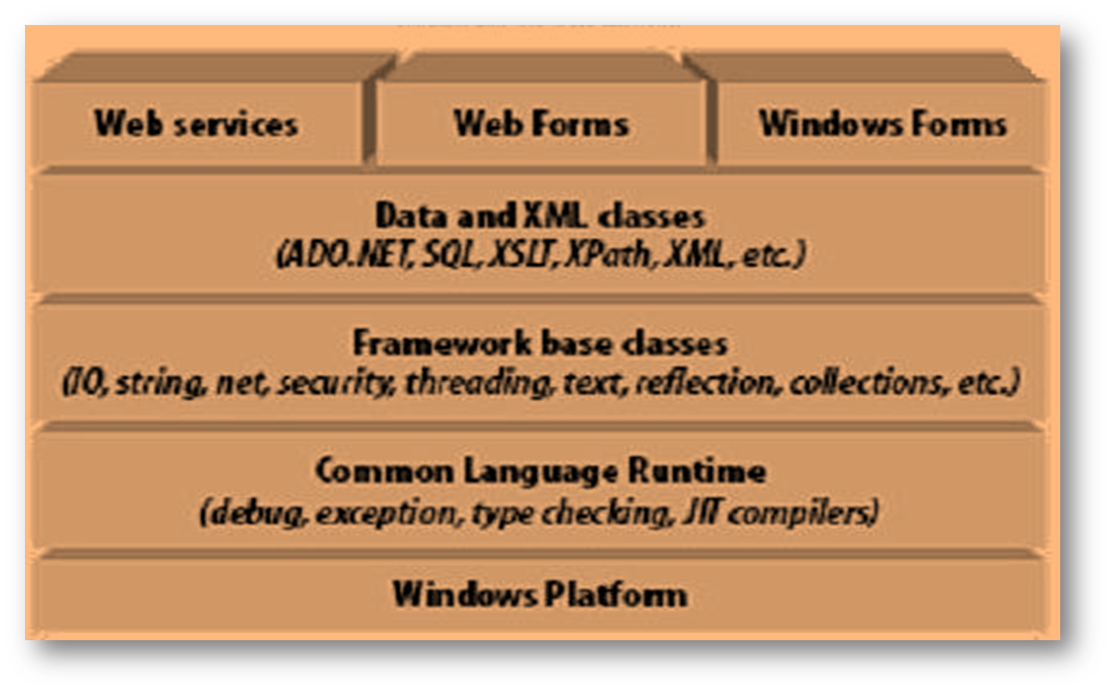
.NET Framework Architecture
Notes:
.NET framework sits on the top of the operating system. .Net is essentially a system application.
.NET framework consists of a number of components. The most important component is Common Language Runtime.
CLR activates objects, perform security check on them and execute & garbage-collect them.
CLR supports all languages that can be represented in MSIL (MicroSoft Intermediate Language)
The layer on the top of CLR is a set of framework base classes. These classes are organized in Namespaces. .NET provides classes for input/output, threading, network communication, security management, text and collections.
On the top of the framework base classes is a set of classes extending base classes for data and XML management. This set of classes is referred as ADO.NET. The XML classes provide capability for XML Data management, XML searching and XML translations.
On the top of ADO.NET and XML, there are classes for Web Services, Web Applications and Windows applications.

Slide 5
Common Language Runtime
Design Goals
Dramatically simplifies development and deployment
Unifies programming models
Provides robust and secure execution environment
Supports multiple programming languages
Notes:
Let’s look at what the design goals for the .NET Framework are:
Simplified development – make developers lives easier and more productive.
allow devs to focus on better algorithms and on solving business problems.
not implementation details of idiosyncrasies
OO features, consistent api throughout using common design patterns, hierarchical namespaces
Simplify Deployment – simply lower TCO to a reasonable level
self describing apps, no registry, fix DLL Hell
Unified programming models – VB, VC (MFC), Vid (ASP) all have diverging models. These development models needed to come together to in order to deliver on simplicity and productivity, especially amongst teams of developers
Robust and Secure – We designed the platform to do everything it can to make your applications more robust and secure. Automatic memory management, Type safety guarantees, and structured exception handling all contribute to your applications being more robust and secure.
Mulit-language platform – All programming languages are first class on the .NET Framework. They have the same access to the underlying platforms. None of the languages are in a penalty box. If you have been a closet Cobol (or any other language) user for years, now is the time to come out! Your language is first class on this platform.

Slide 6
Architectural Overview
Framework
Base Classes
Common Language Runtime
IL to
native code
compilers
Execution
Support
Security
GC, stack walk, code manager
Class loader and layout

Slide 7
Compilation And Execution
Compilation
Assembly
Source Code
Language Compiler
Code (IL)
Metadata
Native
Code
JIT Compiler
At installation or the first time each method is called
Execution
Notes:
The diagram above illustrates the process used to compile and execute managed code, that is, code that uses the CLR. Source code written in C#, VB.NET, or some other language that targets the CLR is first transformed into MSIL by the appropriate language compiler. Before execution, this MSIL is JIT compiled into native code for whatever processor the code will run on. The default is to JIT compile each method when it is first called, but it’s also possible to “pre-JIT” the MSIL. With this option, all methods are compiled before the application is loaded, so the overhead of JIT compilation on each initial method call is avoided.
One point worth noting is that all languages targeting the CLR should exhibit roughly the same performance. While some compilers may produce better MSIL code than others, large variations in execution speed are unlikely.

Slide 8
Runtime Execution Model
Assembly
Class
Loader
First reference
to type
IL to native
conversion
Assembly
Resolver
First reference
to Assembly
Managed
Native Code
CPU

Slide 9
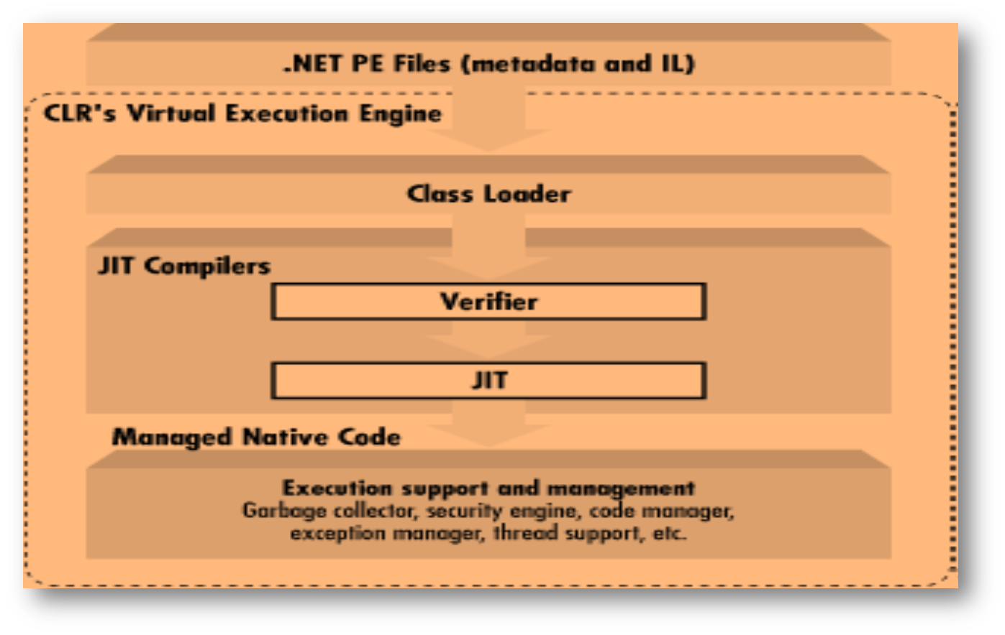
Common Language Runtime
Notes:
The CLR manages and executes code written in .NET languages and is the basis of the .NET architecture.
The major components of Common Language Runtime are class loader, code verifier, Just-In-Time (JIT) compiler and execution support like garbage collection, exception handling, thread management etc.
When you run a standard Windows application, the OS loader loads it before it can execute. Microsoft has provided an updated OS loader for each of its operating systems that support the .NET runtime.
When you run a .NET application on one of these systems that has an updated OS loader, the OS loader recognizes the .NET application and thus passes control to the CLR. The CLR then finds the entry point, which is typically Main( ), and execute the application. Class loader finds the class containing Main() and loads the class.
Whenever object of some class is instantiated, the class loader first loads the class. Everytime a new type is referenced class loader starts executing.
The class loader loads .NET classes. It finds the classes in GAC (Global Assembly Cache), Metadata and any application configuration file. Assembly is a .NET .dll or .exe file. GAC is central repository for assemblies. Metadata is available in assembly with information about types in assembly, assembly itself, external referred assemblies and resources etc.
Type safety is the fundamental concept in .NET code verification. Code verifier runs to check whether the code is type-safe or not?.
This type-safety check is done at runtime.

Slide 10
Managed Code and MSIL
Code that runs with approval of CLR.
MSIL or CIL (Common Intermediate Language)
MSIL is a platform independent.
JIT Compiler compiles IL code to native code.
Notes:
The code verifier kicks in before IL code execution and after the class is loaded. It checks for:
Metatdata is valid and well-formed.
IL code uses type-signatures correctly i.e. check for type-safety.
The JIT compilers convert IL to native code so that it can execute on the target operating system.
The method which passed code verification will be JIT compiled to managed native code. Managed code is the code which runs with the approval of CLR.
JIT compilation occurs only the first time a method is invoked and cached for reuse when re-invoked same method till the application is restarted.
There are three types of JIT Compilers:
Pre-JIT: It will compile an entire assembly into CPU-specific binary code. This compilation is done at install time, when the end user is least likely to notice that the assembly is being JIT-compiled.
Econo :Econo – JIT compiles only those methods that are called at runtime. However these compiled methods are removed if the system begins to run out of memory.
Standard: It compiles methods as and when required and cache them.

Slide 11
Common Type System (CTS)
It describes the underlying type system supported by .NET runtime.
It specifies how these entities can interact with each other, and details how they are represented in the .NET metadata format.
CLR supports two categories of data-types:
  Value Type
  Reference Type
Notes:
Execution Support and Management:
Garbage Collection: It removes de-referenced objects from memory.
Exception Handling
Security Support: It provides code access security.
Because .NET treats all languages as equal, a class written in C# should be equivalent to a class written in VB.NET, and an interface defined in Managed C++ should be exactly the same as one that is specified in managed COBOL. Languages must agree on the meanings of these concepts before they can integrate with one another. In order to make language integration a reality, Microsoft has specified a common type system to which every .NET language must abide.

Slide 12
Value Types
Value types are allocated on stack.
They cannot be null.
Value types are not garbage collected.
Value types include:
  All intrinsic data types
  Structures,
  Enumerations.
Value-type can be created by deriving a class from System.ValueType class.
Notes:
Value type variables directly contain the value.
Value type:
e.g int i;
struct Point
{
public x as Integer
public y as Integer
}
Class derived from System.ValueType is also a value-type. But it is by default not-inheritable.
When value type is passed to a called function, it is passed by value. Changes in copied value by function do not reflect in actual copy of the variable.

Slide 13
Reference Types
Reference types are allocated on garbage-collected heap.
These can be assigned to null.
Reference Type stores reference to actual value.
Reference Types include:
  Classes
  Arrays, Delegates
  Interfaces.
Notes:
Reference types stores references (addresses) of actual value.
When reference type is passed to a called function, it is passed by reference. Changes in object by function reflect in actual passed object.
Reference type allocated on heap & its address is stored in stack.

Slide 14
Boxing and Un-Boxing
Value types when converted into a heap-based reference-type object, the opertaion is referred as boxing.
  e.g. int i;
  Object o=i; //Boxing
The reverse operation is un-boxing.
  e.g i=(int)o; //Un-boxing

Slide 15
Assembly
Assembly is a .NET .dll or .exe executable file.
An assembly can contain other files such as .html, .gif etc.
All the files in an assembly has same version number.
It serves as basic versioning and deployment unit.

Slide 16
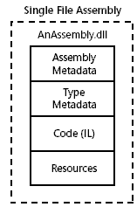
Assembly
It contains metadata in a region, referred as manifest.
Metadata is a data about assembly, types in assembly, externally referred assemblies/resources.

Slide 17
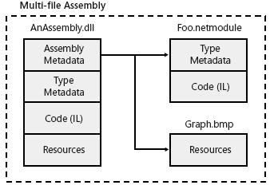
Assembly
Multi-file assembly can be created using command line compiler and linker.
Al.exe is the assembly linker utility.

Slide 18
Global Assembly Cache (GAC)
GAC is a central repository for assemblies.
Assemblies in GAC are referred as Shared Assemblies.
Shared as those can be utilized/shared by multiple applications.
Global Assembly Cache: A directory that holds .NET Framework system and shared assemblies.

Slide 19
Global Assembly Cache
In GAC, .dll can be registered.
gacutil.exe is the command line utility to register the assembly in GAC.
Only strongly named assembly can be deployed to GAC.
Strong name uniquely identifies the assembly.
Strong names facilitate co-existence of different versions of same assembly.

Slide 20
Global Assembly Cache
Strong Name is composed of:
  Assembly name without extension.
  Version Number of the assembly
  Public key of the assembly.
  Culture Identity value.
  Digital Signature ( Hash value + Private Key).
Strong names are based on (in part) public-key and private-key.
sn.exe utility is used to generate keys.

Slide 21
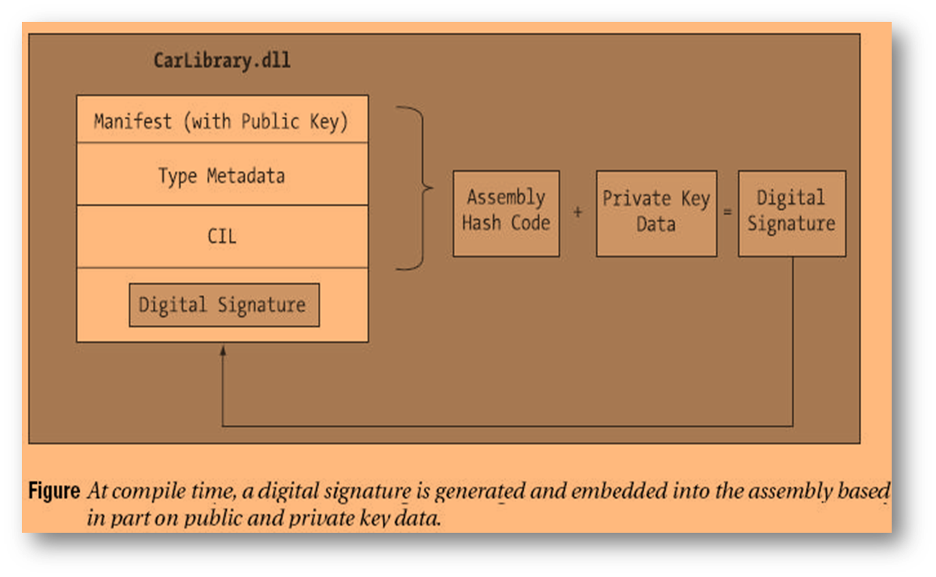
Global Assembly Cache

Slide 22
Language Integration
.NET supports various languages following CLS.
Class created in C# can be extended using VB.NET or any .NET language.
Interface in any .NET language can be implemented by classes of other .NET languages.
This is referred as language integration.
Language integration is possible due to CTS.

Slide 23
Major Namespace in .NET
Class library in .NET is organized in namespaces.
System.IO→ IO manipulation of streams.
System.Collections→ Collection Classes.
System.Threading→Classes for multithreading
System.Data→Common Data Management classes.

Slide 24
Major Namespace in .NET
System.Net→ Classes for network communication
System.Web.UI
System.Web.Services
System.Windows.Forms
System.Reflection→Type inspection & dynamic binding
System.Security→Security Support

Slide 25
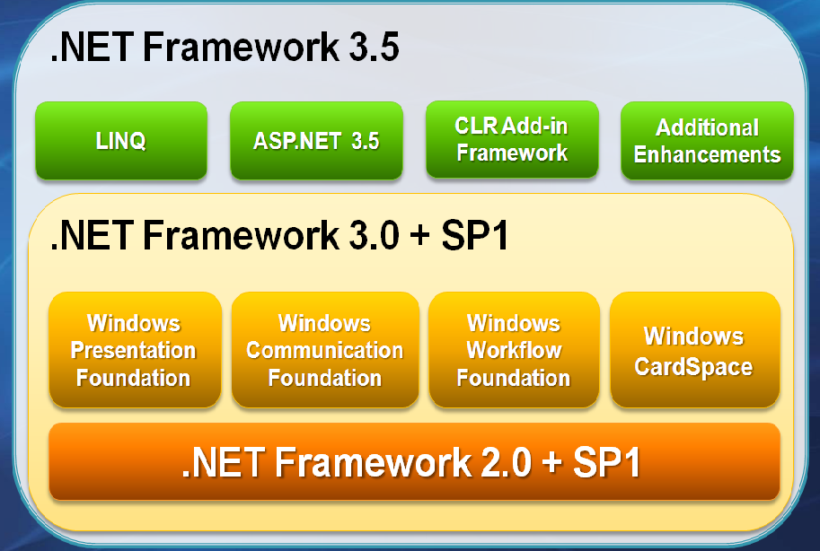

Slide 26
.NET Framework 3.5
The .NET Framework 3.5 is an incremental release of the .NET Framework.
Built on .NET 2.0 & 3.0.
.NET Framework 3.5 has new features like Linq, ASP.NET AJAX built-in, CLR Add-In, New Types.
.NET 3.0 has
  Windows Workflow Foundation
  Windows Presentation Foundation
  Windows Communication Foundation

Slide 27
LINQ
Language INtegrated Query (LINQ)
New programming model for data access that integrates query support directly within the .NET Languages.
Designed to reduce complexity when working with data.
Data access support for any type of data source.

Slide 28
.NET Framework 3.0
Windows Presentation Foundation – provides the ability to build rich, interactive client applications.
Windows Communication Foundation – provides a common programming model for building services and connecting applications.
Windows Workflow Foundation – provides the ability to define declarative, long-running workflows.
Windows CardSpace – provides a safer and more secure alternative to username and password authentication within web sites and rich client applications

Slide 29
Quiz
Size of DateTime is ________ bytes.
Reference types allocated on______.
Nullable type has its roots in ________.
_______ utility is used to generate keys.
______ namespace has classes for type inspection.
___,___, and ___ are three JIT compilers

Slide 30
Quiz
CLR stands for _____________.
Delegate is a _______ type.
Value type can be created by deriving class from ___________ class.
_______ organizes class library in hierarchical way.
double d =2.5, object obj=d; this operation is referred as ___.
Notes:
Common Language Runtime
Reference
System.ValueType
Namespaces
Boxing

